Slide 1
Edinburgh Business School MBA
AUC Academic Partner
Strategic Planning
Cases
Instructor: Moataz Darwish, MBA

Slide 2

Introduction
  The strategist has to think more widely and deeply than the individual functional specialists.
  This is an extremely difficult game to play and it goes without saying that unless you practice you will never get into the top right hand box of Strategic thinking.
EBS MBA / AUC

Slide 3
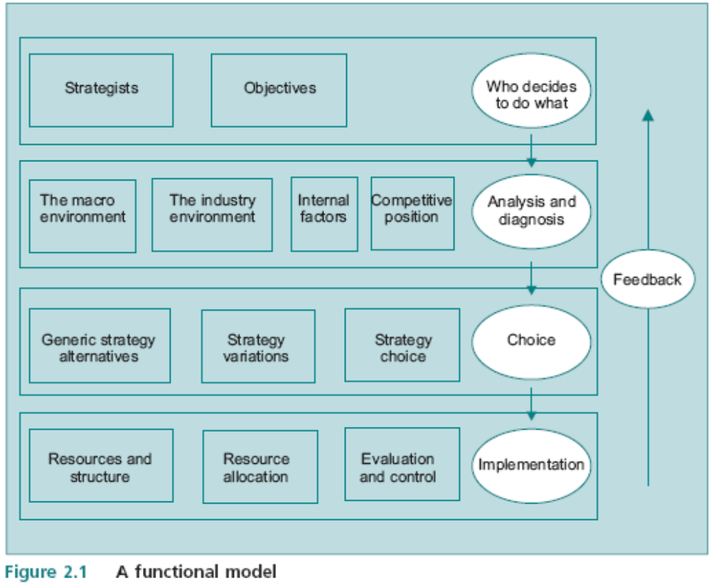
The SP Model
4 rows
5 eggs
12 boxes
EBS MBA / AUC

Slide 4
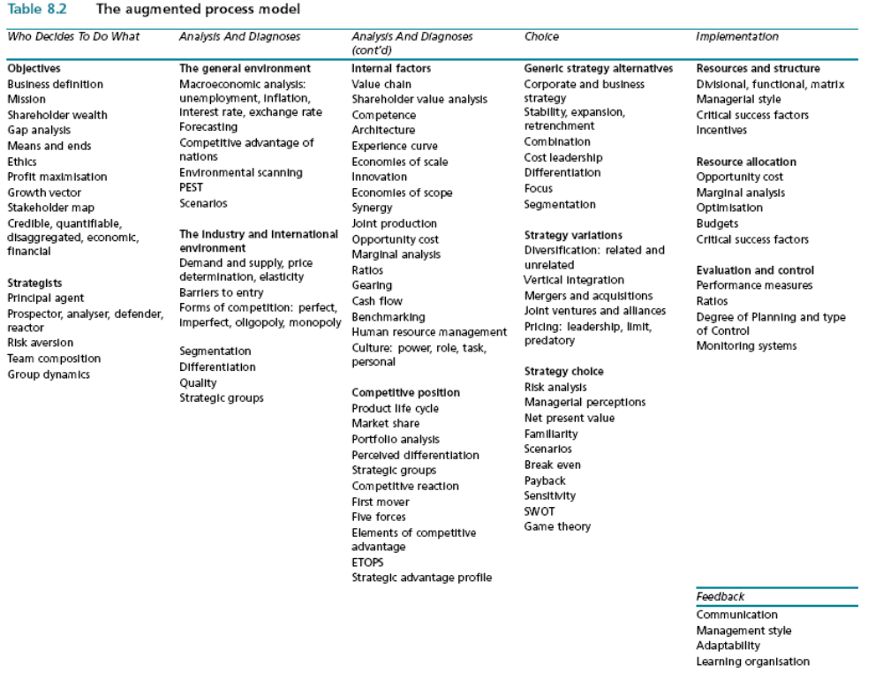
The Augmented Process Model
EBS MBA / AUC

Slide 5
Augmented Model - summary
Who Decides To Do What
Analysis And Diagnoses
Analysis And Diagnoses
Choice
Implementation
OBJECTIVES
Business Definition
Mission
Shareholder wealth
Gap analysis
Means and ends
Ethics
Profit maximisation
Growth vector (Ansoff)
Stakeholder map
Credible, quantifiable,
disaggregated, economic,
Financial
Principal agent
CSR
STRATEGISTS
Prospector, analyzer, defender, reactor
Risk aversion
Principal agent
Team composition
Group dynamics
Corporate Governance
Culture: power, role, task,
personal
THE GENERAL ENVIRONMENT
Macroeconomic analysis:
unemployment, inflation,
interest rate, exchange rate
Forecasting
Competitive advantage of
Nations (Diamond)
Environmental scanning
PESTEL
Scenarios
THE INDUSTRY AND INTERNATIONAL
ENVIRONMENT
Demand and supply, price
determination, elasticity
Barriers to entry
Forms of competition: perfect, imperfect, oligopoly, monopoly
Segmentation
Differentiation
Quality
Strategic groups
INTERNAL FACTORS
Value chain
Shareholder value analysis
Competence (resources/routines matrix)
Architecture
Experience curve
Economies of scale
Economies of scope
Innovation
Synergy
Joint production
Opportunity cost
Marginal analysis
Ratios
Gearing
Cash flow
Benchmarking
Human resource management
Culture: power, role, task,
personal
COMPETITIVE POSITION
Product life cycle
Market share
Portfolio analysis (BCG)
Perceived differentiation
Strategic groups
First mover
Five forces
Competitive reaction
Elements of competitive adv
ETOPS
Strategic advantage profile (SAP)
GENERIC STRATEGY ALTERNATIVES
SWOT
Corporate strategy:
Stability, expansion,
Retrenchment, Combination
Business C strategy: Cost leadership, Differentiation, Focus
Segmentation
Strategy variations
Diversification: related and
unrelated (Fam Matrix)
Vertical integration
Mergers and acquisitions
Joint ventures and alliances
Pricing: leadership, limit,
predatory
Strategy choice
Risk analysis
Managerial perceptions
Net present value
Familiarity Matrix
Scenarios
Break even
Payback
Sensitivity
Game theory
RESOURCES AND STRUCTURE
Divisional, functional, matrix
Managerial style
Critical success factors
Incentives
Resource allocation
Opportunity cost
Marginal analysis
Optimisation
Budgets
Critical success factors
Evaluation and control
Performance measures
Ratios
Degree of Planning and type of Control
Monitoring systems
FEEDBACK
Communication
Management style
Adaptability
Learning organisation

Slide 6
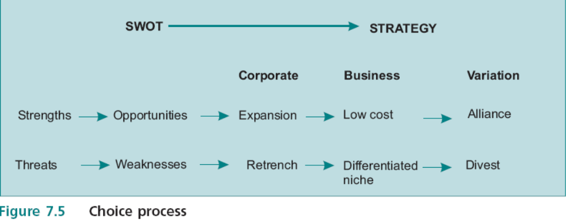
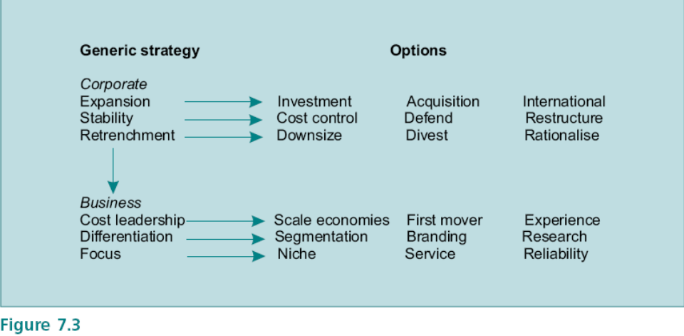
SWOT to Strategy
ETOP
Short term
Corporate
SBU
Ex. Cost/mkt share/efficiency
SWOT
SAP
Long Term
Corporate
SBU
Ex. Move along Ansoff matrix
In strategic terms the distinction is between actions that are intended to deal with immediate issues (short term), such as reducing cost to avoid bankruptcy, rather than those that deal with the basis on which the company competes, such as building competences, developing a portfolio and adjusting market position to generate competitive advantage (Long term). There is often a conflict between the need to deal with the immediate imperatives and building long term competitive advantage; this can be a permanent feature of companies in a volatile environment in which there is a continual need to make trade offs.

Slide 7
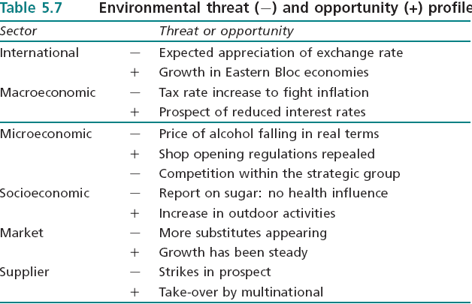
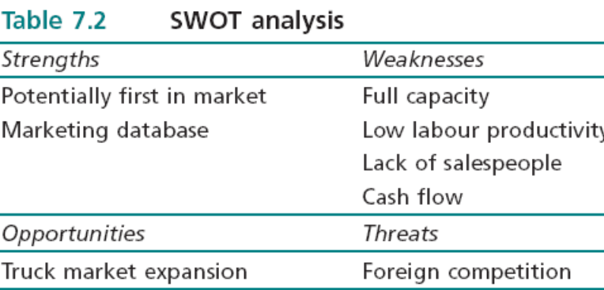
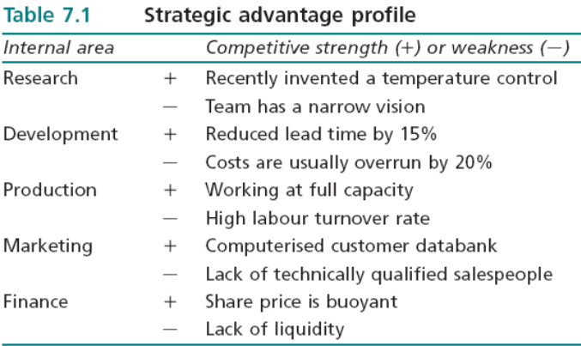
Objective –> Strategy -> Recommendations
Environmental/Industry/Internal Scanning
ETOP
SWOT
SAP

Slide 8
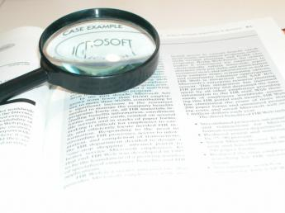
SP Exam
Question 1: Data Based Case (1/3 of the exam grade)
Question 2: Real Life Case (1/3 of the exam grade)
  Identify what the story is about - success/failure/new venture…etc
  Identify reasons/causes (ex. for the failure…)
Question 3: Essay (1/3 of the exam grade)
  Present a balanced argument (for and against)
  Arrive to conclusion backed w/ argument
  Plenty of opportunities to incorporates ideas
EBS MBA / AUC

Slide 9
Exam Tips
Examination grading
Each of the three questions in the examination carries equal weighting.
Usually each question consists of more than one part, but marks are not specifically awarded to each individual part.
This is because there is often a degree of overlap among different parts and the examiner takes an overall view of how the question was answered.
Obviously if part of a question is not tackled, the mark will be downgraded.
Finally, the examination paper as a whole is evaluated in terms of its analytical content, the application of strategic concepts, any insights and the quality of the arguments; in marginal cases, the decision is made on the basis of overall content rather than simply taking the sum of the marks on the three questions.
Long vs. short term (see notes below)
EBS MBA / AUC
Notes:
The short run and long run
In most of the cases there is a point when you ask us to make suggestion on long-term and short-term actions for a company by applying the SWOT matrix. Can you distinguish between long term and short term? As I see, the long-term actions are concerned mostly with generic strategy issues both on business level and corporate level, but can you help me regarding short-term actions?
The treatment of short and long run in the strategy literature is typically confused. The following is an extract from a paper I recently produced that addresses this issue.
There are several operational definitions of the short and long run in the strategic context; for example, the difference can be expressed in terms of the time period in which performance is measured: the short term could be profitability targets in the next two years while the long run could be profitability on a recurrent basis over a five year horizon. But this type of definition is arbitrary and actually misses the point: the difference is one of type rather than of time period. In economics the terms have particular meanings that are not related to actual time periods, i.e. the short run is the period in which only one factor of production varies, while in the long run all factors are variable; this distinction is essential for understanding ideas such as economies of scale. In strategic terms the distinction is between actions that are intended to deal with immediate issues, such as reducing cost to avoid bankruptcy, rather than those that deal with the basis on which the company competes, such as building competences, developing a portfolio and adjusting market position to generate competitive advantage. There is often a conflict between the need to deal with the immediate imperatives and building long term competitive advantage; this can be a permanent feature of companies in a volatile environment in which there is a continual need to make trade offs. It greatly complicates the pursuit of competitive advantage because the long run objective is continuously obscured by immediate concerns; this is one reason why many organisations find it difficult to ‘think strategically’.

Slide 10
Exam Tips
No right and wrong answers
Read the question first
Put things in order (STUCTURE) - note taking (closet organizer),
(Case →Model → Tools->Analyses->conclusion)
Don’t simply mention the tool/concept…APPLY IT, Explain WHY you’re applying a certain tool/concept
Make use of ALL data…it’s there for a purpose
Leave space after every case and sub-sections of the model to revisit if possible
Have a go at ALL Questions and ALL PARTS of Questions
Time Management: apply the 1:00 – 1:25 – 0.75 rule
Watch out for comparisons in the single case (between 2 periods, 2 companies…), that would entail duplicating the model structure of both.
Do not panic because you have not completely filled in the answer book; we are looking for good quality applications and reasoned arguments.
EBS MBA / AUC

Slide 11
Case Study Analyses
Put things in order – note taking – closet organizer
Case
Relate to
Break down to
Deduct
Paragraphs
Model
Tools
Analyses
Matrices
Key (Buzz)
words
Concepts
EBS MBA / AUC

Slide 12
‘Focus on Nestlé’ Case
Question 2, Jun 07 Exam
Required:
1. What changes to the strategic process in Nestlé did Mr Brabeck introduce after taking over from Mr Maucher?
2. There is some doubt on future strategic moves. Set up a SWOT analysis and advise Mr Brabeck on a course of action.
EBS MBA / AUC

Slide 13
Active-Reading Methodology - Nestlé’ Case
By 2004 Nestlé, a Swiss food and drink group,
was by far the biggest in its sector.
For twenty years, Nestlé had been growing through
a series of acquisitions and new market entries,
but its CEO, Mr Brabeck, still had plans to
maintain or even increase its rate of growth.
In order to do so he recognized that he would
have to transform Nestlé from being a group of
Unrelated businesses into an efficient and coordinated operation.
Objective->Name+what industry?
Implementation->org str
Industry/Internal->Mkt share
Past objective -> growth
Past Strategy->expansion-> >Acq.+mkt entry (Ansoff?)
Strategist->Defender?
Objective->max profit?
Strategy->stabilization?
Strategy->from unrelated diversification to
internal efficiency through change mgt
-> from expansion to stabilization?

Slide 14
Exercise
Please practice the active-reading methodology for the rest of the case and solve the case accordingly.

Slide 15
Nestlé’ Case
A major difference between Mr Brabeck and His competitors is the approach to growth.
While Nestlé was expanding, most of the other big companies in the sector either shrank or remained stable. For example, between 2000 and
2004, Unilever cut its workforce by 14%, closed 100 factories, and reduced its brands from 1600
to 400. In 2003, Cadbury announced the closure of 25 factories and a 10% reduction in the
workforce. Yet while Nestlé kept growing, its profit margins lagged behind those of its major
competitors. It has been argued that Nestlé should have returned cash to shareholders rather
than using it to fund growth but, on the other hand, between 1975 and 2004, Nestlé’s share
price rose by about three times the S&P index.
The growth trail
Nestlé’s current growth trajectory began under Mr Brabeck’s predecessor, Mr Maucher, who took
over in 1981 after Nestlé had made a misguided expansion into hotels and restaurants. Mr
Maucher sold off the unprofitable businesses and decided that Nestlé would focus on mineral
water,ice cream, pet food and confectionery. In 1988, Mr Maucher bought Rowntree, famous for
Kit Kat and Smarties, and in 1992 Perrier; he also purchased the market dominant ice cream
makers in Spain, Australia and Canada. When he took over in 1997, Mr Brabeck continued
buying, culminating in 2001 with the purchase of Ralston Purina, a US pet food company, for $10
billion; this made Nestlé one of the two biggest pet food makers in the world.
EBS MBA / AUC

Slide 16
Nestlé’ Case
Mr Brabeck versus Mr Maucher
The two CEOs initially appeared to have a similar approach and issued a circular setting out what
would not change under Mr Brabeck. There were two ‘unique’ features they wished to preserve:
first, IT would not be important in the day to day running of Nestlé because the focus was on its
people, products and brands; second, the commitment to decentralisation would remain to
cater to local tastes and maintain emotional links with distant clients.
But within two years Mr Brabeck recognised that these ‘unique’ features were not contributing to
competitive advantage. Decentralisation was abandoned with the establishment of SBUs
dealing with similar products. But this was resisted by many managers who did not want to
lose their independence; the result was a management shake-out. But Mr Brabeck was now
faced with a conundrum. Companies such as Danone, which focused only on water, diary
products and biscuits, were doing better than Nestlé. So the question had to be faced whether
focus was necessary in the food industry. At the same time, the attempt to transform Nestlé into a
global business ran the risk of losing the ability to adapt to local conditions. For example, there are
200 varieties of Nescafé, the instant coffee brand. Mr Brabeck turned his attention to cost cutting
and efficiency and closed 150 under-performing factories; he also aimed to reduce administrative
costs by 1% by 2006. In 2000, Mr Brabeck June 2007launched the ‘Global Business Excellence’ project
with SAP, a German software company, to develop a company wide resource planning
system which will be based on one technology platform providing more accurate information on
raw materials and stock levels. This standardisation is necessary because different
versions of software are in use because of the legacy from acquisitions. There was no
coordination in purchasing, resulting in Nestlé paying 20 different prices for vanilla to the same
supplier. In some regions, such as the US and Asia, steps have already been taken to
standardise systems with considerable success. But whether this can be made to work at a global
level remains to be seen. It had not taken Mr Brabeck long to dispense with
the two ‘unique’ features. But some analysts claim to have been puzzled that Mr Brabeck
signed up to those in the first place, and that he was now acting in the same way as other CEOs of
big complex companies.
EBS MBA / AUC

Slide 17
Nestlé’ Case
Some lurking issues
There is some doubt as to how long it will take to make the new resource planning system fully functional. The initial
prediction was for 2006, revised to 2007, and some analysts doubt whether it will be running before 2010. This will
inevitably delay the full transformation of Nestlé that Mr Brabeck needs to compete effectively. Nestlé is so well known that
it is exposed to a high level of reputational risk. In the 1970s, Nestlé was involved in a scandal that it has never
shaken off over sales of baby-milk formulae in poor countries. In 2002, Nestlé made a blunder by trying to extract payments
from Ethiopia, which at the time was impoverished. Continuing efforts are directed at maintaining Nestlé’s reputation which
is essential for a food company; the consumer complaints hotlines follow up every complaint; also, every year some products
are withdrawn. The obesity epidemic has forced Nestlé to reconsider its image and Mr Brabeck is attempting to reposition
Nestlé as a ‘food, nutrition, health and wellness’ company. A new Nutrition division has been created that produces
clinical nutrition, performance nutrition and baby food. Nestlé is now selling a ‘new nutritional message’ that food provides
health benefits rather than making people fat. By 2004, Nestlé had introduced 600 new or reformulated products in 50
countries by adding minerals and vitamins to products such as yogurt and ice cream. But there is no guarantee of success
even in the new health conscious climate. For example, the new line of yogurts, LC1, that is meant to improve the

Slide 18
Nestlé’ Case
even in the new health conscious climate. For example, the new line of yogurts, LC1, that is meant to improve the
immune system and digestion, failed in several European countries in the face of competition
from a similar product Actimel, produced by Danone. The push into new markets is continuing, and
Nestlé is willing to enter countries such as Iraq and Iran so long as there is a free market, a large
enough population, and a welcome for foreign investors. The result was that organic growth
(excluding acquisitions) from 1999 to 2003 was 5.7% compared with 2.7% for Unilever; but there
are significant risks associated with entering new and untried markets.
Any attempt to grow further by acquisition is likely to cause problems with antitrust laws.
There is also the problem that existing portfolios do not often fit; for example, if Nestlé went
ahead with a potential acquisition of General Mills it would probably have to sell off about half the
business. Nestlé still has some non-core businesses. It has major ownership of Alcon, an ophthalmological equipment maker,
and L’Oréal, the French cosmetics company. It has been rumoured that Nestlé is considering acquiring total ownership of
L’Oréal and producing innovative nutritional cosmetic products. The big issue is whether Mr Brabeck will make any further acquisitions before Nestlé transforms itself into an effective global company with strong controls and a low cost base.

